Slide 1
Boosting Algorithms

Slide 2
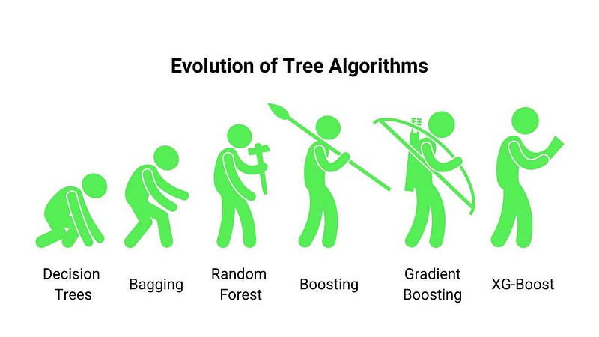
Evolution of Decision Tree

Slide 3
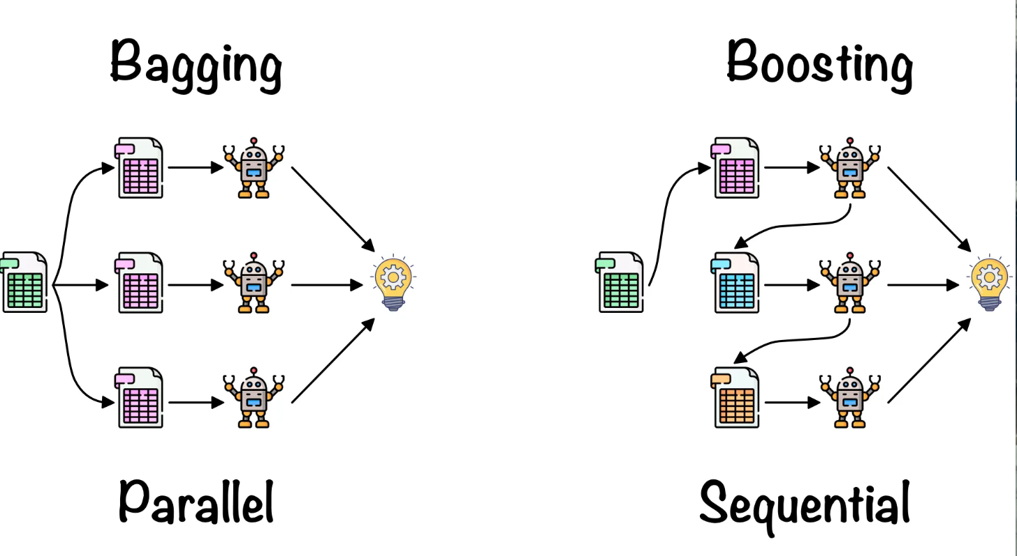
Ensemble Learning Techniques
Bagging Key Idea : Use multiple base learners which are trained separately with a random sample from the training set, which through a voting or averaging approach, produce a more stable and accurate model.
Boosting Key Idea : To align multiple models in a sequence so that they can learn from the errors of the other models and at the final stages they provide higher accuracy

Slide 4
Boosting Algorithm Types
LG Boosting
XG Boosting
Ada Boosting

Slide 5
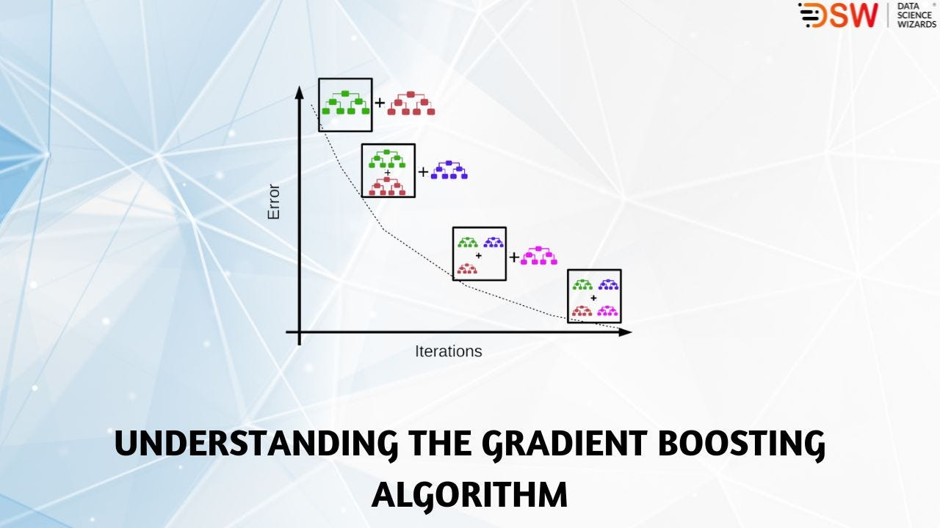
Gradient Boosting
GB Idea : To align multiple models in a sequence so that they can learn from the errors of the other models and at the final stages they provide higher accuracy using the gradient descent method to optimize the parameters of the new model in boosting.

Slide 6
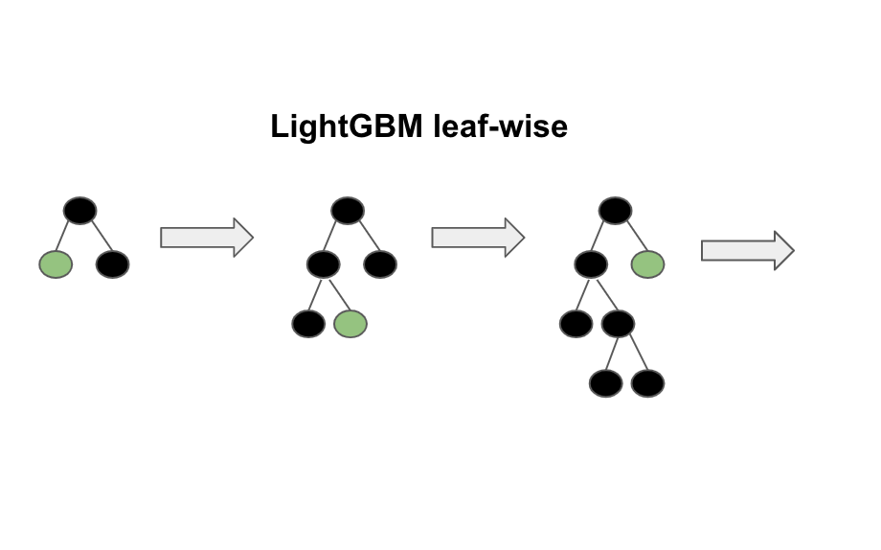
LG Boosting – LGB (Light Gradient Boosting)
LGB is a fast, distributed, high-performance gradient boosting framework based on decision tree algorithm which is used for ranking, classification, trees, to increase the efficiency of the model, to reduce the memory usage and many other machine learning tasks.

Slide 7
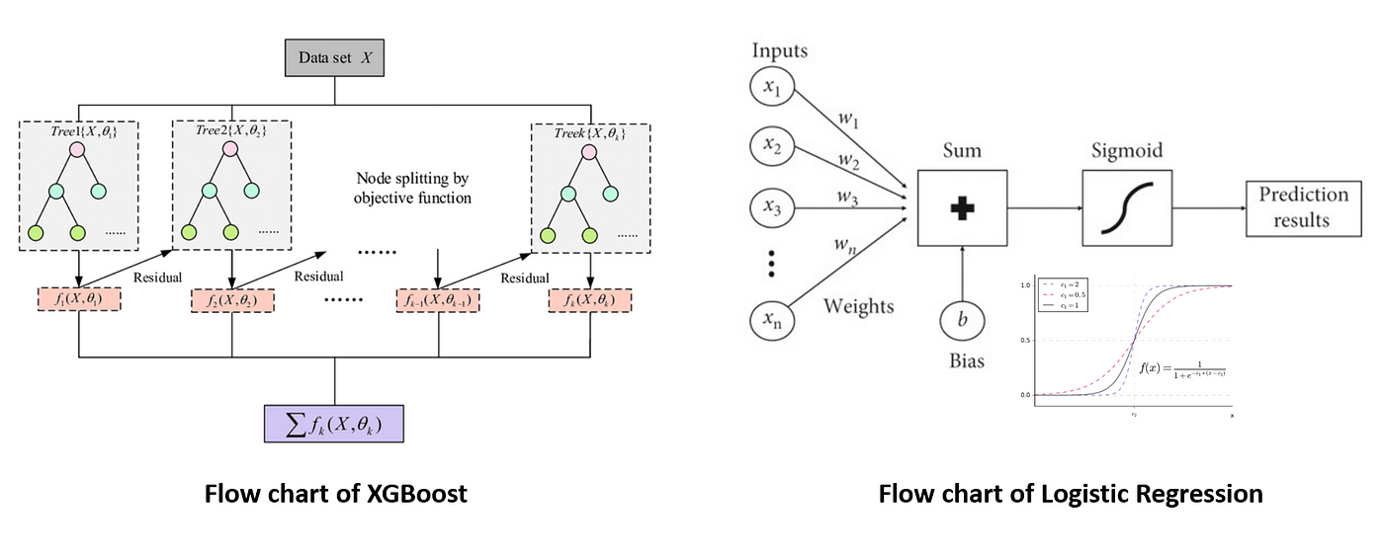
XG Boosting (Extreme Gradient Boosting)
XG Boosting - a scalable, distributed gradient-boosted decision tree (GBDT) machine learning library.

Slide 8
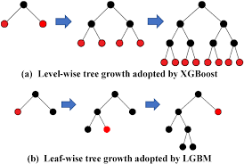
LG Vs XG Boosting

Slide 9
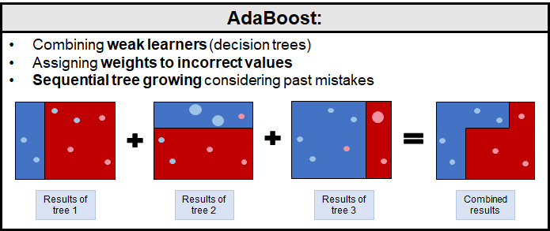
Ada Boosting (Adaptive Boosting )
It is used to classify data by combining multiple weak or base learners (e.g., decision trees) into a strong learner.

